Slide 1
Visualizing Spatial Microbial Localization in the Colon: An R-based Approach
Maysen Hauck

Slide 2

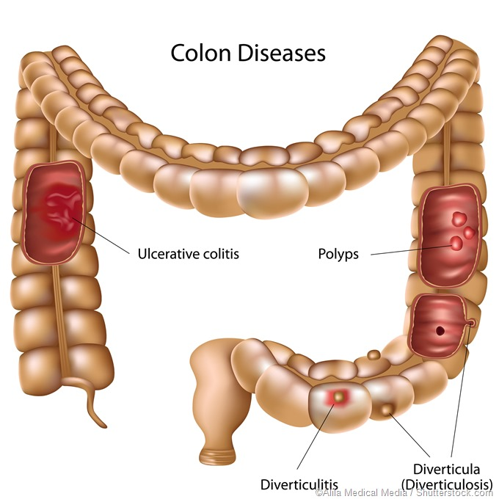
Colon Region Associated Diseases
The human colon contains distinct anatomical regions, each playing different roles in the digestion and absorption processes
Within these regions, there is an association of specific colon-related diseases prevalence

Slide 3
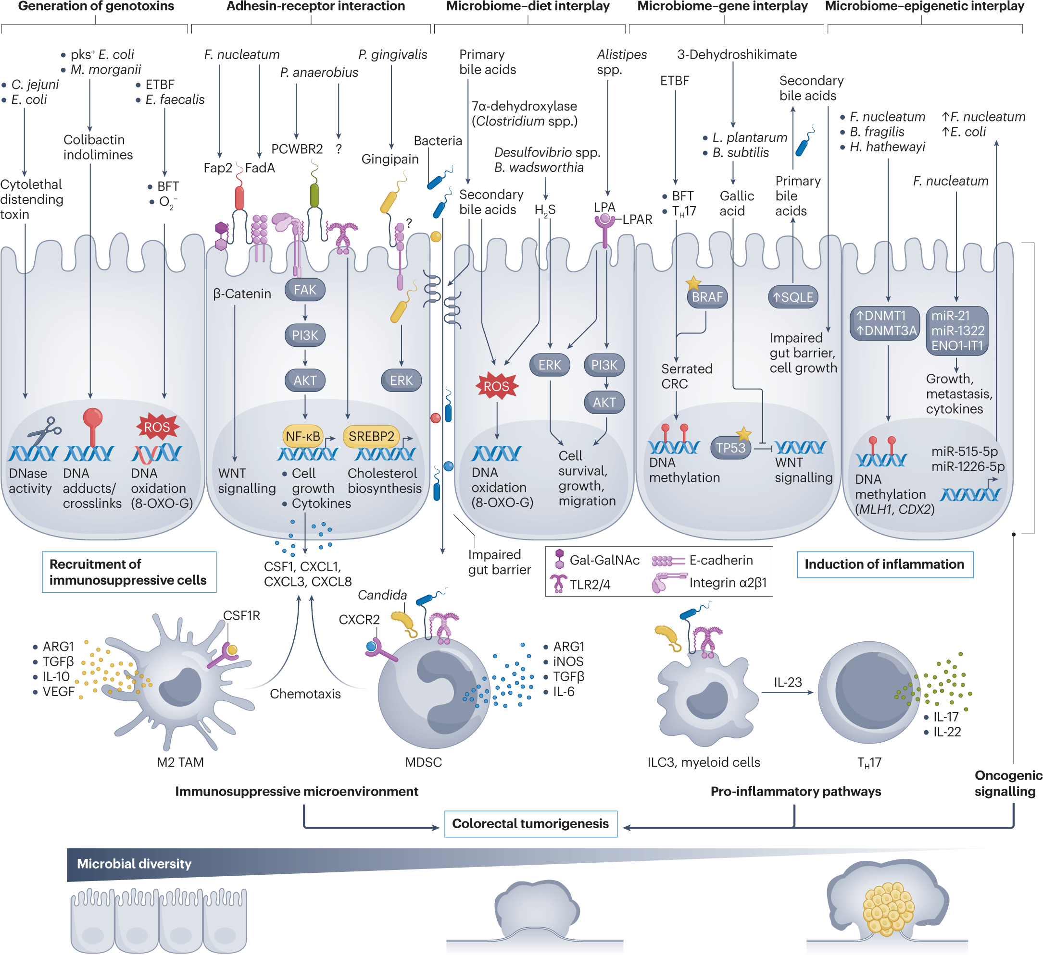
The Gut Microbiome and Disease Association
Microbial variation across these regions is linked to local disease development
Colorectal cancer (CRC) has been associated with spatial colonization patterns, particularly enrichment of pathogens like Fusobacterium nucleatum in specific regions.
Understanding these spatial dynamics is key to identifying microbiome-based biomarkers and interventions

Slide 4
Research Question
How do bacterial species vary in their abundance and spatial distribution across anatomical regions of the colon, and is there a correlation to disease prevalence by region?

Slide 5
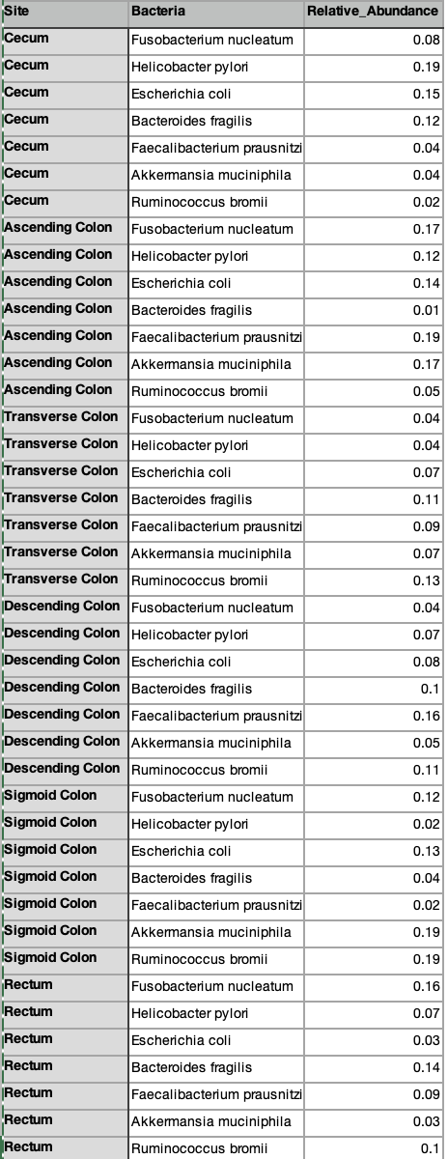
Steps Taken to Address Question
Step 1: Creation of a mock microbial abundance data using a Large Language AI Model (ChatGPT)
Step 2: Used the R packages tidyverse, ggplot2, and ggimage to generate desired output

Slide 6
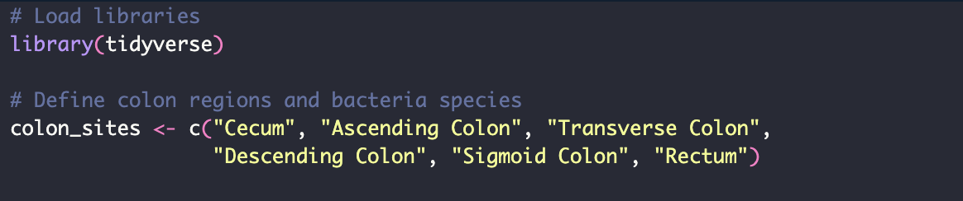
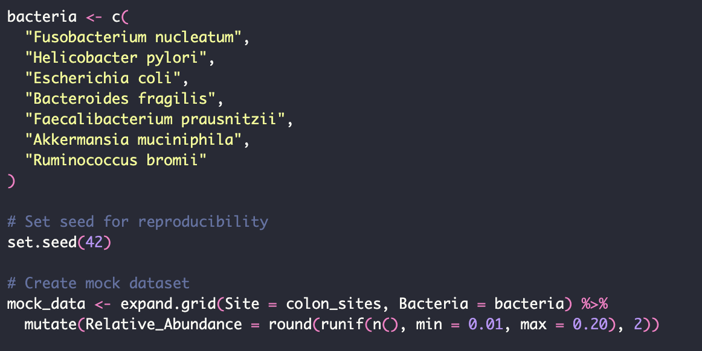
Code Set- Heat Map

Slide 7
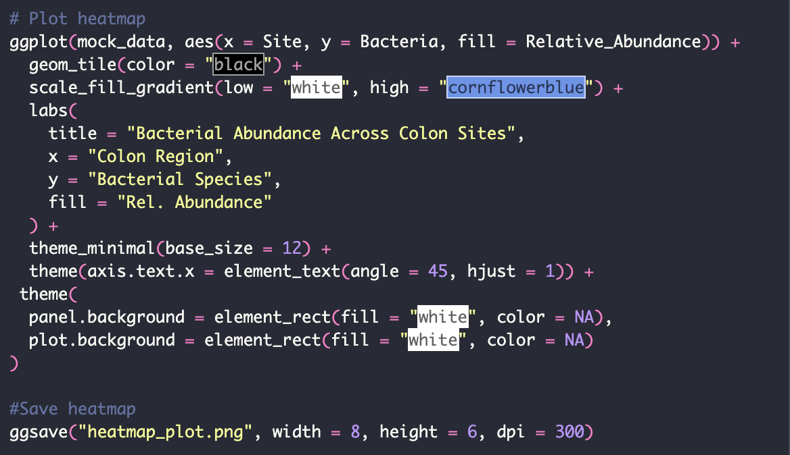
Code Set- Heat Map

Slide 8
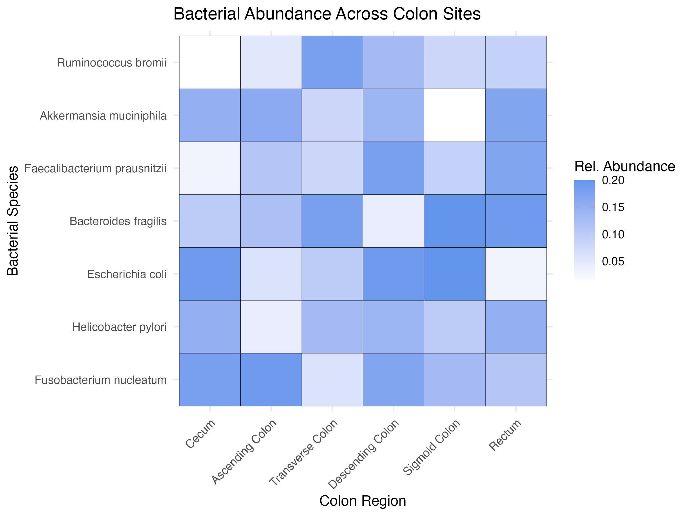
Heatmap Demonstrating Bacterial Abundance Across Colon Sites

Slide 9
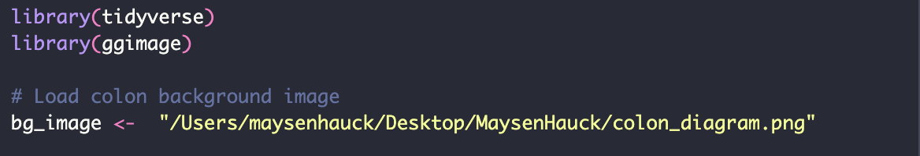
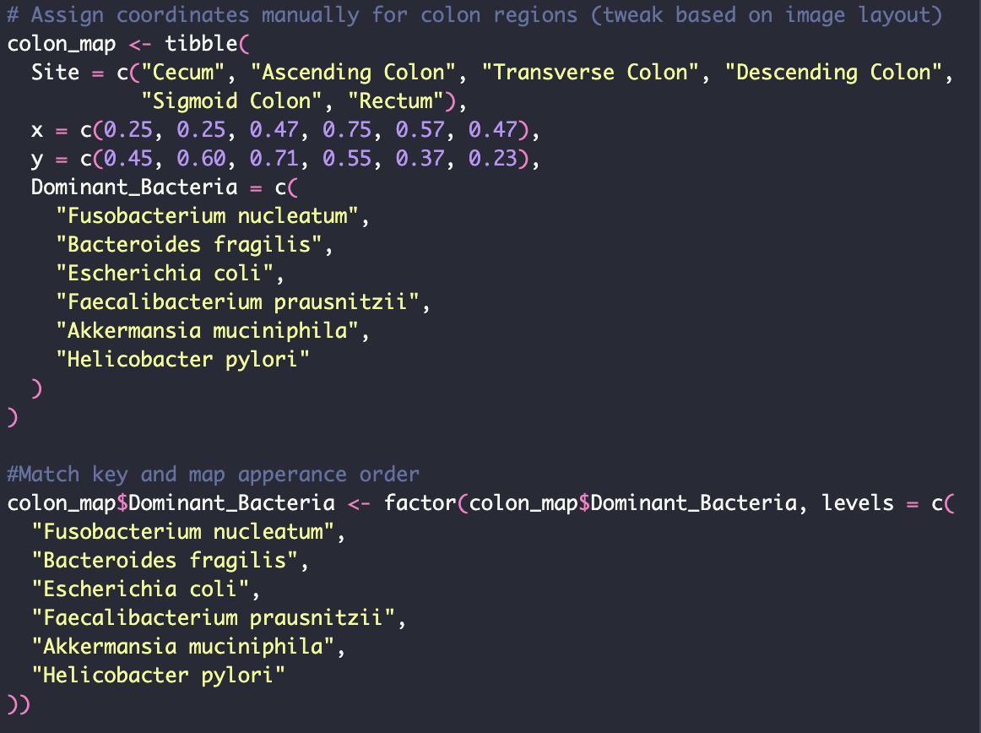
Code Set- Colon Diagram

Slide 10
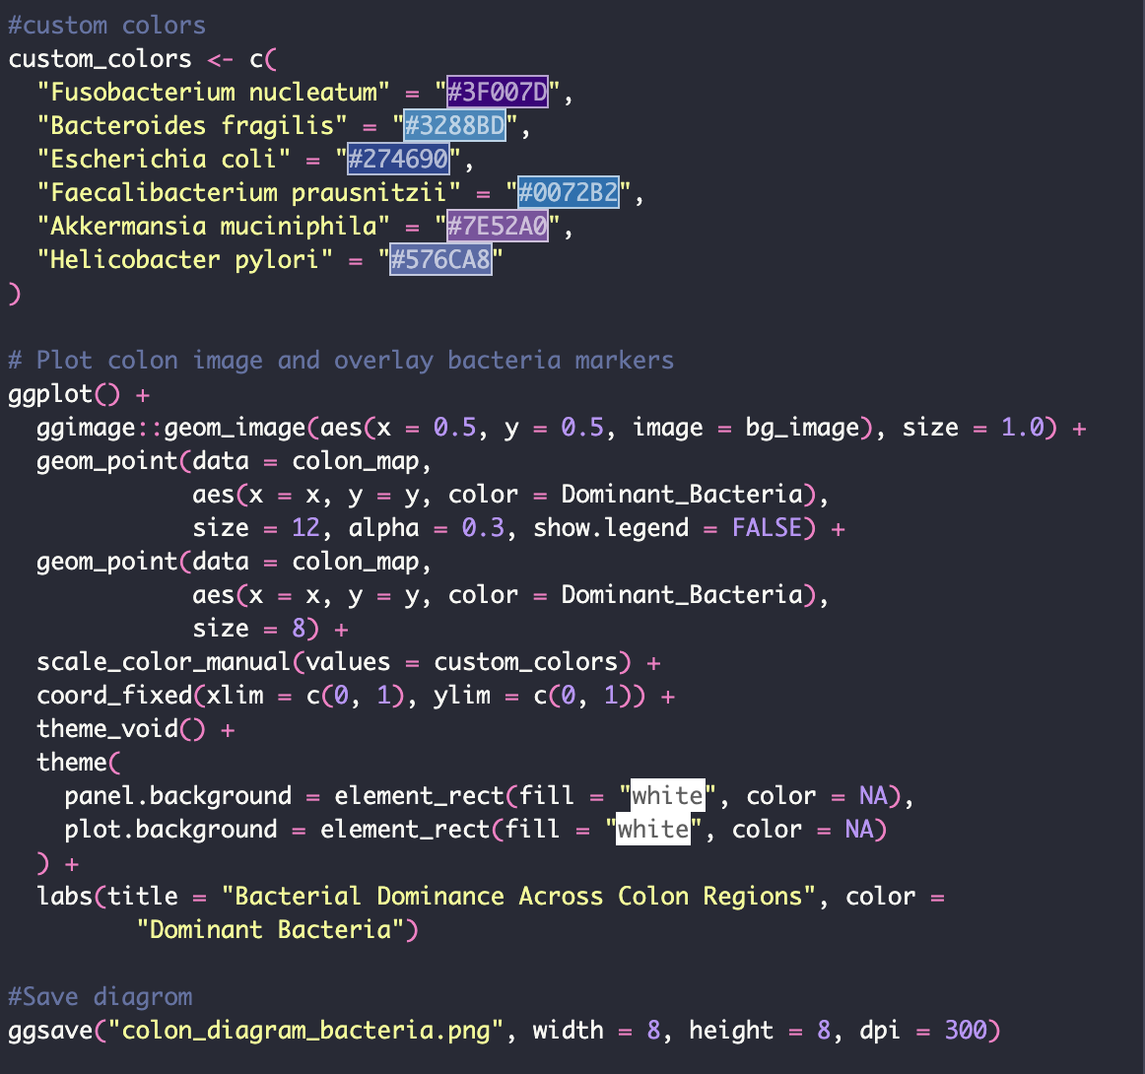
Code Set- Colon Diagram

Slide 11
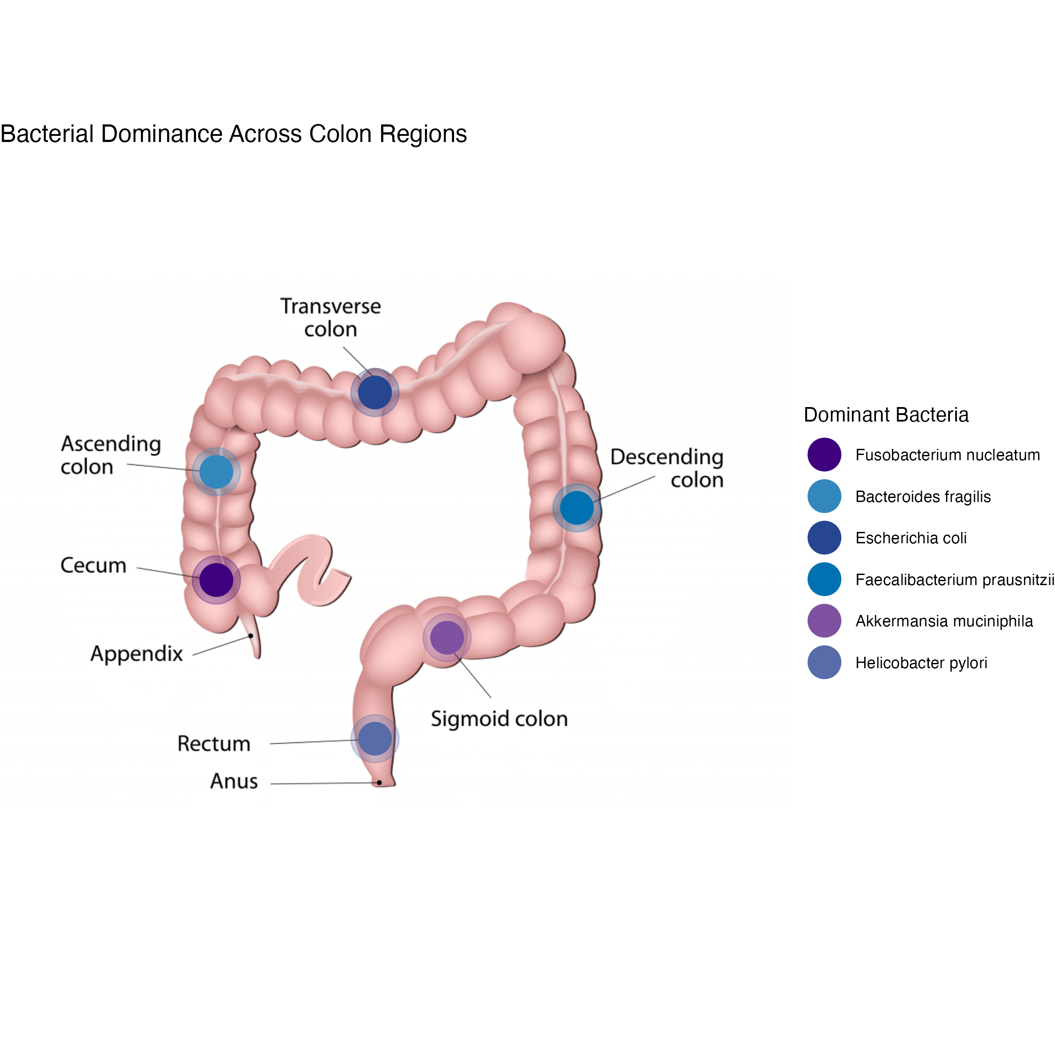
Diagram of Colon Regions Demonstrating Dominant Bacterial Species Associated with Each Region
Notes:
Dot size and color customized to enhance interpretability.

Slide 12
Interpretation of Data Figures
Heat Map
Reveals variation in bacterial abundance across different regions of the colon.
Some species (e.g., Escherichia coli, Bacteroides fragilis) show broad distribution, while others like Fusobacterium nucleatum are concentrated in specific areas.
Helps identify regional microbial patterns that may relate to function or disease association.
Colon Diagram
Provides a spatial visualization of the dominant bacterium in each anatomical region.
Emphasizes site-specific microbial trends that can be lost in table or heatmap views.

Slide 13
Future Directions
Integrate real microbiome sequencing data from human colon samples through fecal sample, tissue sample, or generated and manipulated organoids
Expand to include temporal or disease-state comparisons (CRC vs. healthy)
Create an interactive web application using R’s Shiny package, where users could:
Select specific bacteria to highlight across colon regions
Upload custom abundance data for instant visualization
Makes analyses accessible to non-coders, ideal for education, research, or clinical interpretation

Slide 14
References
McMurdie, P. J., & Holmes, S. (2013). phyloseq: An R package for reproducible interactive analysis and graphics of microbiome census data. PLoS One, 8(4), e61217.
Callahan, B. J., et al. (2016). DADA2: High-resolution sample inference from Illumina amplicon data. Nature Methods, 13(7), 581–583.
Martino, C., et al. (2021). A novel interactive microbiome visualization tool for spatially resolved data. Nature Methods, 18(5), 511–519.
Knight, R., et al. (2018). Best practices for analyzing microbiomes. Nature Reviews Microbiology, 16(7), 410–422.
Tropini, C., Earle, K. A., Huang, K. C., & Sonnenburg, J. L. (2017). The gut microbiome: Connecting spatial organization to function. Cell Host & Microbe, 21(4), 433-442.
Gu, S., Chen, Y., Zhang, X., Lu, H., & Lv, T. (2013). Bacterial community mapping of the intestinal tract in colorectal cancer patients. Microbial Ecology, 66(2), 460-470

Slide 15
Questions?

